Slide 1
Working with Text
Notes:
In this short chapter, we're going to show how to draw text in a <canvas> element. This is appropriate if you want to include text as part of your graphics, but you shouldn't use this approach to general display on the Web page.
We'll also introduce the concept of Web fonts, as represented by WOFF files.

Slide 2
Contents
Drawing text in a canvas
Web fonts
Demos folder for this chapter:
Demos\09-Text
Notes:
Section 1 describes how to draw text in a canvas, using a particular font, location, fill/stroke style, etc.
Section 2 explains what Web fonts are, and why they are useful.

Slide 3
1. Drawing Text on a Canvas
Drawing solid and outline text
Text placement
Additional techniques
Notes:
You can draw solid and outline text on a canvas. You have to specify the location of the text, and you can also specify information such as horizontal alignment, vertical alignment, and so on.
We'll show how to do all this in this section.

Slide 4
Drawing Solid and Outline Text (1 of 2)
To configure the appearance of text:
To draw text:
// Set the font.
ctx.font = aFont;
// Set the fill style for text etc.
ctx.fillStyle = aColourOrPattern;
// Set the outline style for text etc.
ctx.strokeStyle = aColourOrPattern;
// Draw solid text.
context.fillText("Some text", x, y);
// Draw outline text.
context.strokeText("Some text", x, y);
Notes:
The canvas 2D context object has fillText() and strokeText() methods, which draw filled text or outline text at the current pen location, using the ambient font and colour scheme.
You can set the font and colour scheme beforehand, via the font, fillStyle, and strokeStyle properties.

Slide 5
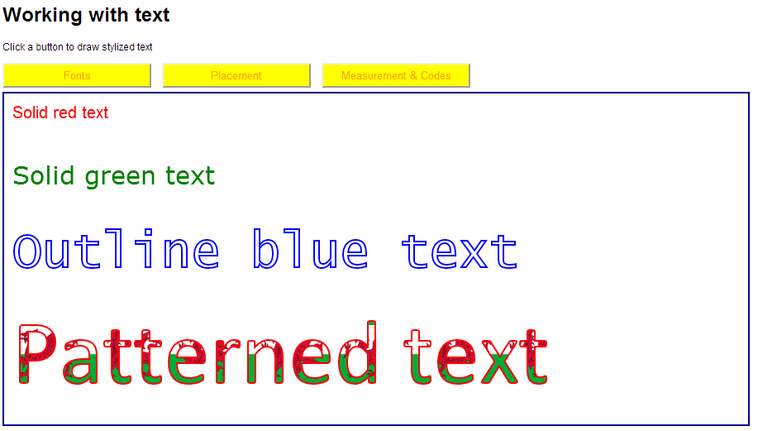
Drawing Solid and Outline Text (2 of 2)
Example of drawing text
Open Text.html
Click the Fonts button
Notes:
This example shows how to draw solid text and outline text, using a variety of fill/stroke styles, and using various different fonts and colour schemes.
For example, this is how the outline blue text is displayed:
context.font = "60px 'Lucida Console'";
context.strokeStyle = "blue";
context.strokeText("Outline blue text", 10, 210);

Slide 6
Text Placement (1 of 2)
To set text alignment:
To set the text baseline:
ctx.textAlign = 'left' | 'center' | 'right' |
'start' | 'end';
ctx.textBaseline = 'top' | 'middle' | 'bottom' |
'hanging' | 'alphabetic' |
'ideographic';
Notes:
You can specify the horizontal text alignment for subsequent text drawing operations, via the textAlign property.
You can specify the vertical baseline for the subsequent text drawing operations via the textBaseline property.
See the following slide for an example of both of these properties.

Slide 7
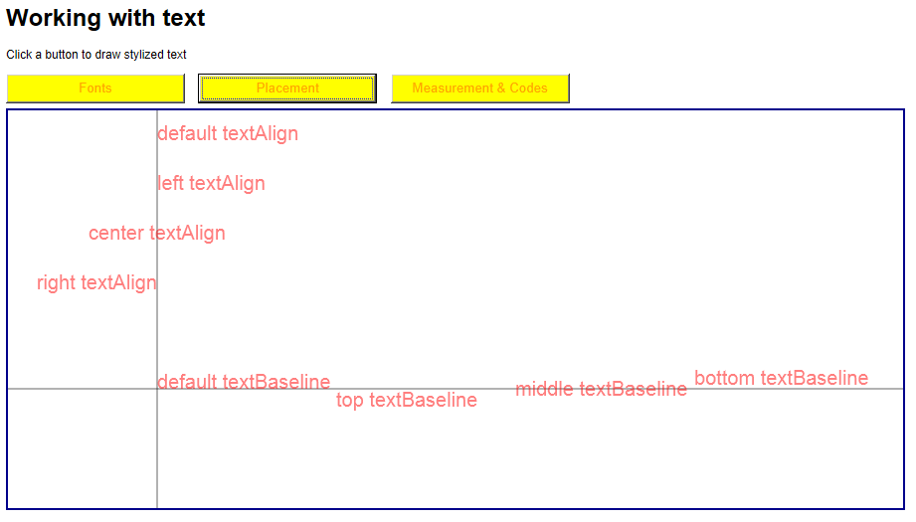
Text Placement (2 of 2)
Example of text placement
Open Text.html
Click the Placement button
Notes:
This example shows how to specify the alignment and baseline for text drawing operations. We've also drawn a couple of axes on the canvas, to emphasize the effect of the text alignment and text baseline properties.

Slide 8
Additional Techniques (1 of 2)
To get metrics information about some text:
To display special characters, such as :
var metrics = ctx.measureText(someText);
var width = metrics.width;
var eacute = String.fromCharCode(0xE9);
Notes:
You can measure the width of some text in a canvas drawing, via the measureText() function. You pass the string of text as a parameter, and the function returns a metrics object that has a width property (note that the height of the text is already known, via the font size).
As an aside, you can use the String.fromCharCode() method if you want to draw special characters such as ê, é, è, etc.

Slide 9
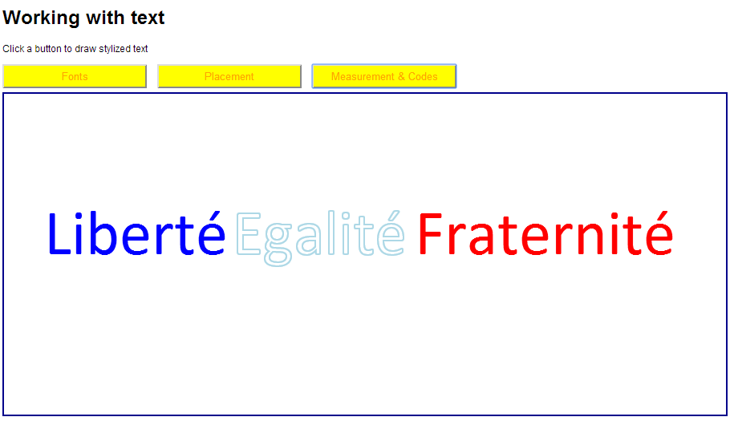
Additional Techniques (2 of 2)
Example of additional techniques
Open Text.html
Click the Measurement & Codes button
Notes:
This example shows how to measure the width of a piece of text, so that you know where to display the next piece of text (e.g. in a different colour and/or font).
The example also shows how to display special characters such as é.

Slide 10
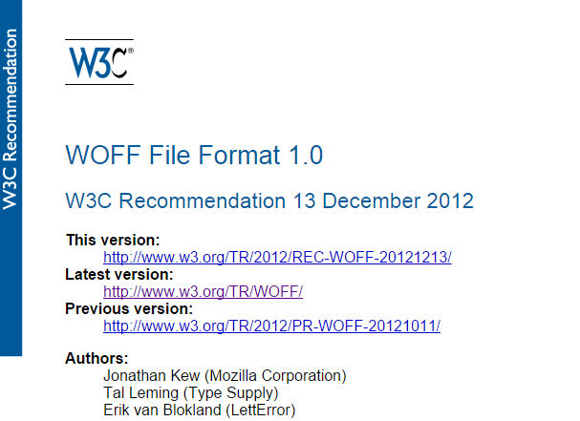
2. Working with Web Fonts
Obtaining WOFF Files
Font Linking
Enabling Variations of Linked Fonts
Example
Notes:
The CSS3 Fonts module enables you to use exotic fonts as direct text in your website, rather than having to create an image
This involves a new web font format, i.e. Web Open Font Format (WOFF). WOFF is a compressed wrapper for other font formats (e.g. TrueType, OpenType, Open Font Format) and is widely supported in modern browsers.

Slide 11
Obtaining WOFF Files
You can obtain WOFF files from font foundries
These fonts have been created by typographic companies
Available for web use via web font services
Most web font services require a subscription
Some offer no-cost trials and/or no-charge plans for basic use
Some require a one-time fee for a download
Notes:
There are several popular web font services available, including:
http://www.fonts.com/web-fonts
http://typekit.com
http://www.typotheque.com/webfonts
http://www.fontsquirrel.com (for free fonts)

Slide 12
Font Linking
In CSS, use @font-face to declare and reference a web font family
Associates a font-family name with a WOFF file (plus other font objects, if you want to support multiple formats)
You can then reference the font declaration via your designated font family name
E.g. in a style sheet, in a script block, etc.
@font-face {
font-family: MyFont;
src: url('MyFontFile.woff'),
url('MyFontFile.ttf'),
url('MyFontFile.eot');
}
.myCssClass {
font-family: MyFont, Arial, sans-serif;
font-size: 14pt; …
}
Notes:
The upper code box in the slide shows how to define a new font face. The font face has a font-family name of your choice, and refers to a set of font files (e.g. installed on the server).
The lower code box shows that you use the font face just like any other fonts, i.e. set the font-family property to the name of your font face.

Slide 13
Enabling Variations of Linked Fonts
You can declare a variation of a linked font, based on:
Font weight (boldface)
Font style (italics)
Font stretch (condensed/expanded)
@font-face {
font-family: MyFont;
font-weight: bold;
src: url('MyBoldFontFile.woff');
}
.myCssBoldClass {
font-family: MyFont, Arial, sans-serif;
font-weight: bold;
font-size: 14pt; …
}
Notes:
You can define and use a bold variant of a font face, as shown in the slide. It's also possible to define and use an italics variant of a font face as follows:
@font-face {
font-family: MyFont;
font-style: italic;
src: url('MyItalicFontFile.woff');
}
.myCssItalicClass {
font-family: MyFont, Arial, sans-serif;
font-style: italic;
font-size: 14pt; …
}

Slide 14
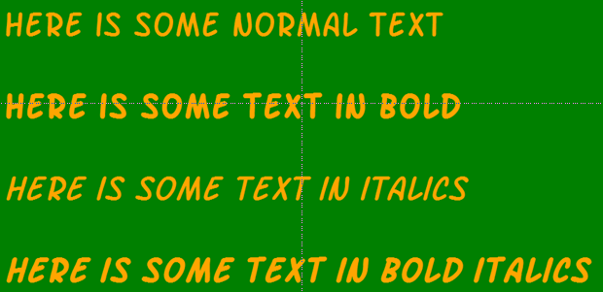
Example
See UsingWebFonts.html
CSS style sheet references WOFF files (plus other font formats)
Notes:
The example in the slide shows the use of WOFF font files. Note the following points:
Line 1 is normal weight, not italic.
Line 2 is bold, not italic.
Line 3 is normal weight, in italics.
Line 4 is bold, in italics.

Slide 15
Any Questions?

